Slide 1

MyPrepMate
Group No. 8
Meet Popat 21
Puranjay Potnis 22
Medha Kumble 24
Date of presentation: 24-11-2020
Under the guidance of: Ms. Purnima Kubde
St. Francis Institute of Technology
Department of Information Technology

Slide 2

Content
Introduction
Objective and scope of project
Problem definition & Proposed solution
Comparative study of Existing systems
Hardware & Software requirements
User Interface Design
Results and Discussions
Conclusions
Future Scope
Literature Cited (book, web & paper References)

Slide 3
Introduction
•MyPrepMate is an online study platform that aims at the benefit of students in various disciplines of education
•It provides the right tools for each course as it aims to bring out the best in each student
•Access to online video lectures, study notes, quizzes
•It also helps to prepare every student fully for an examination
•Students have access to vast online library

Slide 4
Objective and Scope of project
•All online video lectures, study notes and last-minute preparation material is available on this one website
•Students can accelerate their learning with a quick quiz as part of revision
•Online library containing e-books for different subjects
•Access to courses and study material

Slide 5
Problem definition & Proposed solution
•Problem definition:
In today’s day and age online learning is booming. Every student can, from the comfort of their homes, access the internet and learning is on their fingertips. But each of these websites faces a problem and that is all their tools aren’t down to one place. While one website provides the course, another might provide answers to the questions, and another provides the study materials and tutorials, while another might have related books to the subject material.
•Proposed solution:
By not only providing tools for learning on the platform, resources like books, past year question papers must also be available to the students. A discussion forum along with expert advice from faculties as well as testing methodologies help the student excel all while staying on the same website. This not only reduces the problem of long searches but also the problem of ease of access.

Slide 6
Comparative study of Existing systems
Sr. No. | Features | 1st Website (Coursera) | 2nd Website (Tutorialspoint) | 3rd Website (Udemy) | MyPrepMate
1 | Course Listing | Yes | Yes | Yes | Yes
2 | Login & Registration system | Yes | Yes | Yes | Yes
3 | E-books | No | Yes | No | Yes
4 | Embedded videos | Yes | Yes | Yes | Yes
5 | Overview | Yes | No | Yes | Yes
6 | Quiz | Yes | Yes | No | Yes
7 | Payment system | Yes | Yes | Yes | No

Slide 7
Hardware & software requirements
Hardware:
RAM - 2gb and more
Processor – intel processor with 32-bit support or more
Internet Connection – Should be available
CPU – Intel SL7PR or late
Software:
OS – Windows
Text Editor – Notepad/Sublime Text
Web Browser – Google Chrome

Slide 8
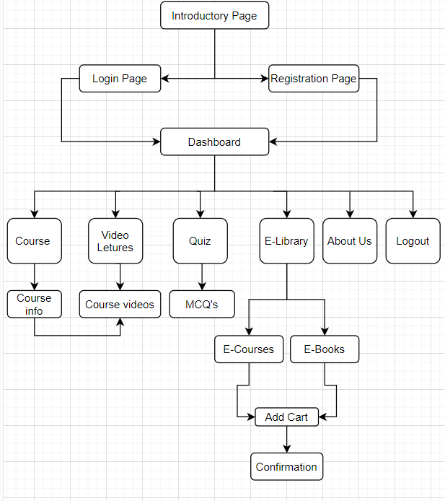
Blueprint of the website

Slide 9
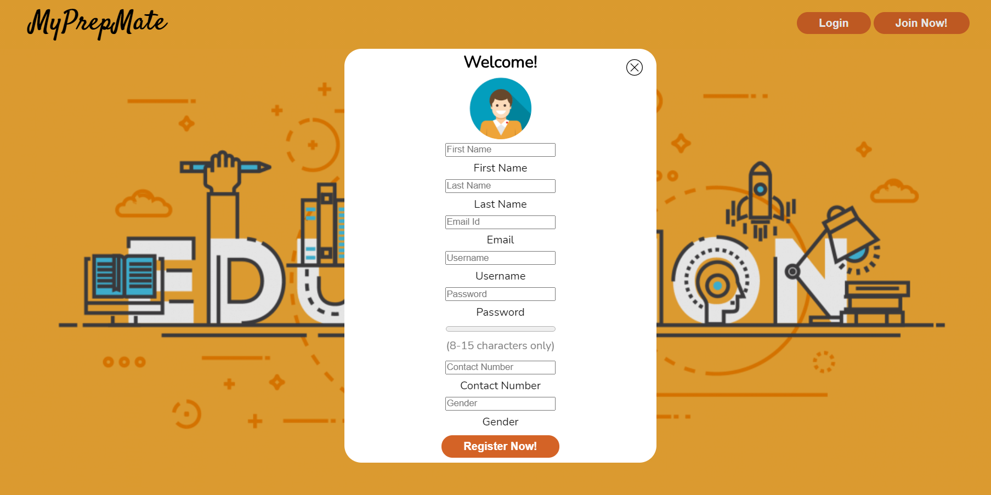
User Interface Design
Figure 1. Registration page

Slide 10
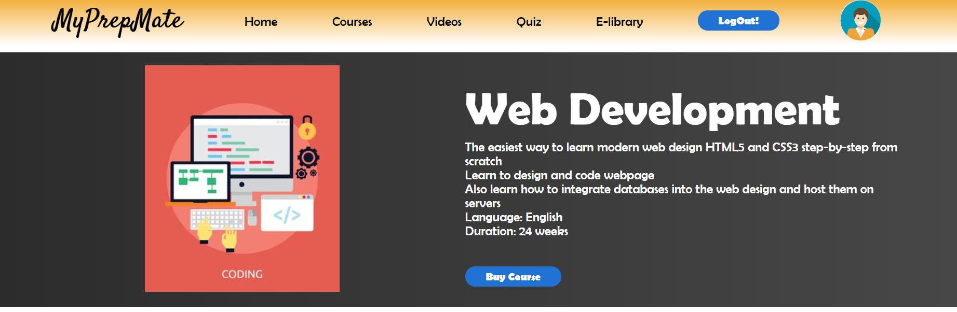
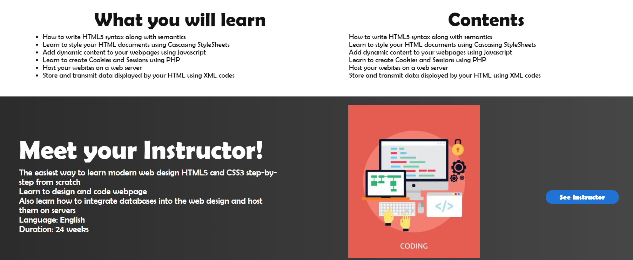
User Interface Design
Figure 2. Course page

Slide 11
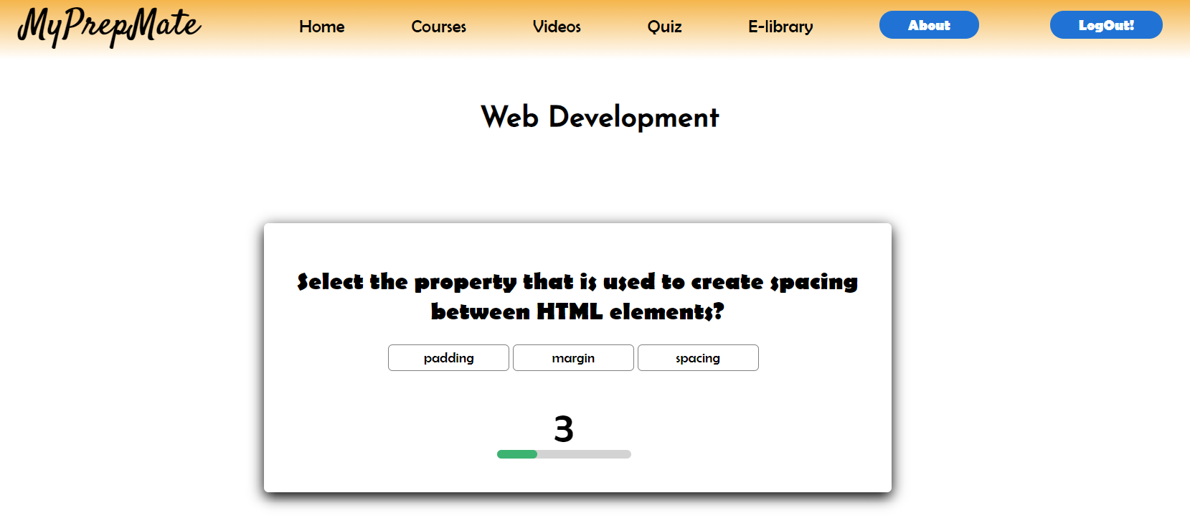
User Interface Design
Figure 3. Quiz page

Slide 12

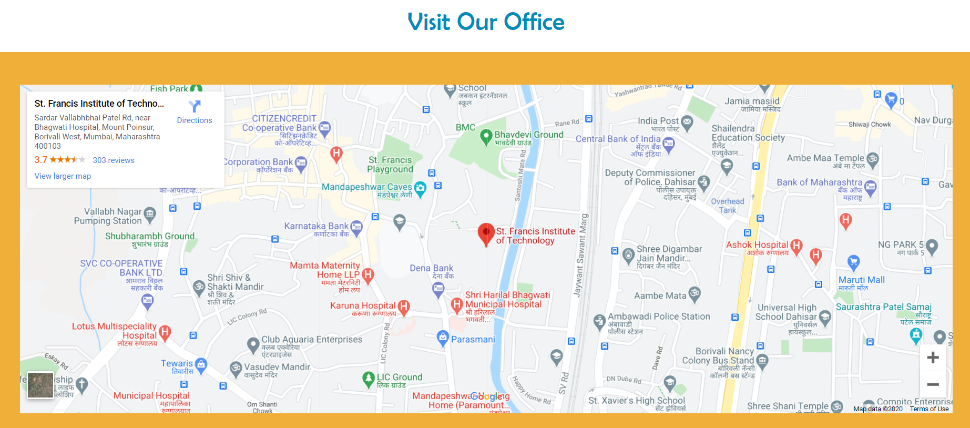
User Interface Design
Figure 4. About Us page

Slide 13
Results and Discussions
Sr. No. | Technology used | Function/feature/technique | Part of the website
1 | HTML5,CSS3, JavaScript | NAVIGATION BAR | ALL PAGES
2 | CSS3,JavaScript | ANIMATIONS | DASHBOARD, INTRO PAGE
3 | HTML5,CSS3, JavaScript | IMAGE CARDS | DASHBOARD, COURSE PAGE
4 | HTML5 | EMBEDDED LINKS | VIDEO PAGE
5 | HTML5 | FORM VALIDATION | LOGIN PAGE, REGISTRATION PAGE
6 | JavaScript | VERIFICATION | LOGIN PAGE, REGISTRATION PAGE
7 | JSON, AJAX | QUESTIONS | QUIZ
8 | HTML5 | GOOGLE MAP | ABOUT PAGE

Slide 14
Conclusions
MyPrepMate website is as an online study platform that is beneficial as all the study material is available on a single website.
The website helps the users to login to the website with the use of the login/registration system .
Each page is written using HTML5 semantics and styled using concepts of CSS3 including a RWD. JavaScript is used to validate input to forms.
To enhance the features of the website even more, we linked different web pages using AJAX, JSON, Geolocation, XML, XSL and web hosting. .

Slide 15
Future Scope
Students at various levels can use this website
Number of questions can be increased in the quiz section
Payment gateway can be added to facilitate the purchase of courses and books
A student statistics section can be maintained
Filtration and search option can be added

Slide 16
Literature Cited
Coursera. 2020. Coursera | Build Skills With Online Courses From Top Institutions, Accessed 22 November 2020. [online] Available at: https://www.coursera.org/
Tutorialspoint.com. 2020. Rxjs, Ggplot2, Python Data Persistence, Caffe2, Pybrain, Python Data Access, H2O, Colab, Theano, Flutter, Knime, Mean.Js, Weka, Solidity, Accessed 22 November 2020. [online] Available at: https://www.tutorialspoint.com/
Udemy. 2020. Online Courses - Learn Anything, On Your Schedule | Udemy, Accessed 22 November 2020. [online] Available at: https://www.udemy.com/
W3schools.com. 2020. W3schools Online Web Tutorials, Accessed 22 November 2020.[online] Available at: https://www.w3schools.com/
Openlibrary.org. 2020. Welcome To Open Library | Open Library, Accessed 22 November 2020. [online] Available at: https://openlibrary.org/

Slide 17
Questions??
Thank You!

